Slide 1


Noida Institute of Engineering and Technology, Greater Noida
Adversarial Search
Unit: 02
Introduction to Search
B Tech 3rd Sem
Alka Singh
CSE(AIML)

Slide 2
Adversarial Search
Adversarial search is a search, where we examine the problem which arises when we try to plan ahead of the world and other agents are planning against us.
In previous topics, we have studied the search strategies which are only associated with a single agent that aims to find the solution which often expressed in the form of a sequence of actions.
But, there might be some situations where more than one agent is searching for the solution in the same search space, and this situation usually occurs in game playing.

Slide 3
Continue…
The environment with more than one agent is termed as multi-agent environment, in which each agent is an opponent of other agent and playing against each other. Each agent needs to consider the action of other agent and effect of that action on their performance.
So, Searches in which two or more players with conflicting goals are trying to explore the same search space for the solution, are called adversarial searches, often known as Games.
Games are modeled as a Search problem and heuristic evaluation function, and these are the two main factors which help to model and solve games in AI.

Slide 4
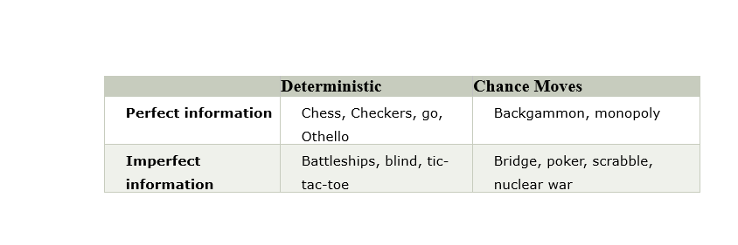
Types of game in AI

Slide 5
Continue…
Perfect information: A game with the perfect information is that in which agents can look into the complete board. Agents have all the information about the game, and they can see each other moves also. Examples are Chess, Checkers, Go, etc.
Imperfect information: If in a game agents do not have all information about the game and not aware with what's going on, such type of games are called the game with imperfect information, such as tic-tac-toe, Battleship, blind, Bridge, etc.

Slide 6
Continue…
Deterministic games: Deterministic games are those games which follow a strict pattern and set of rules for the games, and there is no randomness associated with them. Examples are chess, Checkers, Go, tic-tac-toe, etc.
Non-deterministic games: Non-deterministic are those games which have various unpredictable events and has a factor of chance or luck. This factor of chance or luck is introduced by either dice or cards. These are random, and each action response is not fixed. Such games are also called as stochastic games.
Example: Backgammon, Monopoly, Poker, etc.

Slide 7
Continue…
Note: In this topic, we will discuss deterministic games, fully observable environment, zero-sum, and where each agent acts alternatively.
Zero-Sum Game
Zero-sum games are adversarial search which involves pure competition.
In Zero-sum game each agent's gain or loss of utility is exactly balanced by the losses or gains of utility of another agent.
One player of the game try to maximize one single value, while other player tries to minimize it.
Each move by one player in the game is called as ply.
Chess and tic-tac-toe are examples of a Zero-sum game.

Slide 8
Continue…
Zero-sum game: Embedded thinking
The Zero-sum game involved embedded thinking in which one agent or player is trying to figure out:
What to do.
How to decide the move
Needs to think about his opponent as well
The opponent also thinks what to do
Each of the players is trying to find out the response of his opponent to their actions. This requires embedded thinking or backward reasoning to solve the game problems in AI.

Slide 9
Continue…
Formalization of the problem:
A game can be defined as a type of search in AI which can be formalized of the following elements:
Initial state: It specifies how the game is set up at the start.
Player(s): It specifies which player has moved in the state space.
Action(s): It returns the set of legal moves in state space.
Result(s, a): It is the transition model, which specifies the result of moves in the state space.

Slide 10
Continue…
Terminal-Test(s): Terminal test is true if the game is over, else it is false at any case. The state where the game ends is called terminal states.
Utility(s, p): A utility function gives the final numeric value for a game that ends in terminal states s for player p. It is also called payoff function. For Chess, the outcomes are a win, loss, or draw and its payoff values are +1, 0, ½. And for tic-tac-toe, utility values are +1, -1, and 0.

Slide 11
Continue…
Game tree:
A game tree is a tree where nodes of the tree are the game states and Edges of the tree are the moves by players. Game tree involves initial state, actions function, and result Function.
Example: Tic-Tac-Toe game tree:
The following figure is showing part of the game-tree for tic-tac-toe game. Following are some key points of the game:
There are two players MAX and MIN.
Players have an alternate turn and start with MAX.
MAX maximizes the result of the game tree
MIN minimizes the result.

Slide 12
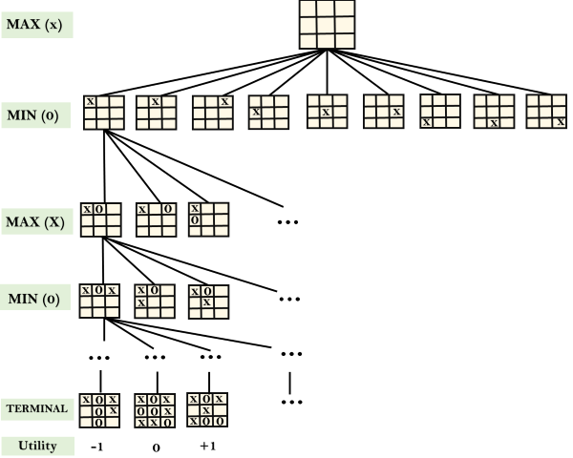
Continue…

Slide 13
Continue…
Example Explanation:
From the initial state, MAX has 9 possible moves as he starts first. MAX place x and MIN place o, and both player plays alternatively until we reach a leaf node where one player has three in a row or all squares are filled.
Both players will compute each node, minimax, the minimax value which is the best achievable utility against an optimal adversary.
Suppose both the players are well aware of the tic-tac-toe and playing the best play. Each player is doing his best to prevent another one from winning. MIN is acting against Max in the game.

Slide 14
Continue…
So in the game tree, we have a layer of Max, a layer of MIN, and each layer is called as Ply. Max place x, then MIN puts o to prevent Max from winning, and this game continues until the terminal node.
In this either MIN wins, MAX wins, or it's a draw. This game-tree is the whole search space of possibilities that MIN and MAX are playing tic-tac-toe and taking turns alternately.
Hence adversarial Search for the minimax procedure works as follows:
It aims to find the optimal strategy for MAX to win the game.

Slide 15
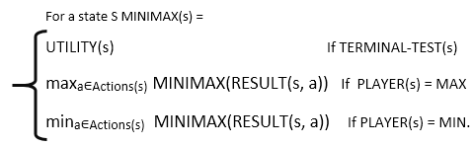
Continue…
It follows the approach of Depth-first search.
In the game tree, optimal leaf node could appear at any depth of the tree.
Propagate the minimax values up to the tree until the terminal node discovered.
In a given game tree, the optimal strategy can be determined from the minimax value of each node, which can be written as MINIMAX(n). MAX prefer to move to a state of maximum value and MIN prefer to move to a state of minimum value then:
Pushkal K Shukla RCS 702 AI Unit 02

Slide 16
Game Theory
Game theory is the logical and scientific study that forms a model of the possible interactions between two or more rational players.
Here rational means that each player thinks that others are just as rational and have the same level of knowledge and understanding.
In the game theory, players deal with the given set of options in a multi-agent situation, it means the choice of one player affects the choice of the other or opponent players.

Slide 17
Game Theory
Game theory and AI are much related and useful to each other. In AI, the game theory is widely used to enable some of the key capabilities required in the multi-agent environment, in which multiple agents try to interact with each other to achieve a goal.

Slide 18
Mini-Max Algorithm in AI
Mini-max algorithm is a recursive or backtracking algorithm which is used in decision-making and game theory. It provides an optimal move for the player assuming that opponent is also playing optimally.
Mini-Max algorithm uses recursion to search through the game-tree.
Min-Max algorithm is mostly used for game playing in AI. Such as Chess, Checkers, tic-tac-toe, go, and various tow-players game. This Algorithm computes the minimax decision for the current state.
In this algorithm two players play the game, one is called MAX and other is called MIN.

Slide 19
Continue…
Working of Min-Max Algorithm
The working of the minimax algorithm can be easily described using an example. Below we have taken an example of game-tree which is representing the two-player game.
In this example, there are two players one is called Maximizer and other is called Minimizer.
Maximizer will try to get the Maximum possible score, and Minimizer will try to get the minimum possible score.

Slide 20
Continue…
This algorithm applies DFS, so in this game-tree, we have to go all the way through the leaves to reach the terminal nodes.
At the terminal node, the terminal values are given so we will compare those value and backtrack the tree until the initial state occurs. Following are the main steps involved in solving the two-player game tree:

Slide 21
Continue…
Step-1: In the first step, the algorithm generates the entire game-tree and apply the utility function to get the utility values for the terminal states. In the below tree diagram, let's take A is the initial state of the tree. Suppose maximizer takes first turn which has worst-case initial value =- infinity, and minimizer will take next turn which has worst-case initial value = +infinity.

Slide 22
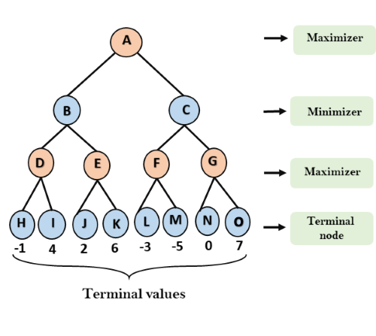
Continue…

Slide 23
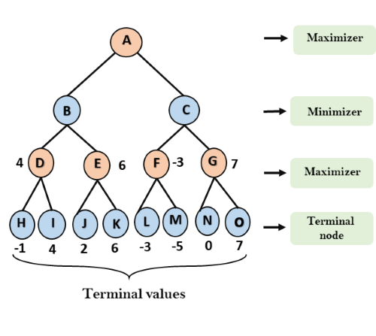
Continue…

Slide 24
Continue…
Step 3: In the next step, it's a turn for minimizer, so it will compare all nodes value with +∞, and will find the 3rd layer node values.
For node B= min(4,6) = 4
For node C= min (-3, 7) = -3

Slide 25
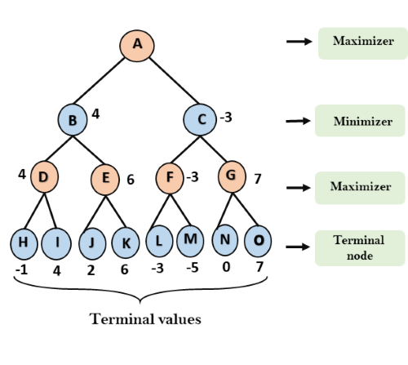
Continue…

Slide 26
Continue…
Step 4: Now it's a turn for Maximizer, and it will again choose the maximum of all nodes value and find the maximum value for the root node. In this game tree, there are only 4 layers, hence we reach immediately to the root node, but in real games, there will be more than 4 layers.
For node A max(4, -3)= 4

Slide 27
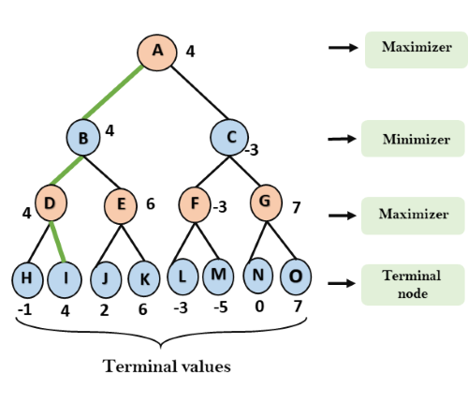

Continue…
That is the complete workflow of the minimax two player game

Slide 28
Continue…
Properties of Mini-Max algorithm
Complete- Min-Max algorithm is Complete. It will definitely find a solution (if exist), in the finite search tree.
Optimal- Min-Max algorithm is optimal if both opponents are playing optimally.
Time complexity- As it performs DFS for the game-tree, so the time complexity of Min-Max algorithm is O(b^{m}), where b is branching factor of the game-tree, and m is the maximum depth of the tree.
Space Complexity- Space complexity of Mini-max algorithm is also similar to DFS which is O(b^{m}).

Slide 29
Continue…
Limitation of the minimax Algorithm:
The main drawback of the minimax algorithm is that it gets really slow for complex games such as Chess, go, etc. This type of games has a huge branching factor, and the player has lots of choices to decide. This limitation of the minimax algorithm can be improved from alpha-beta pruning which we have discussed in the next topic

Slide 30
Alpha-Beta Pruning
Alpha-beta pruning is a modified version of the minimax algorithm. It is an optimization technique for the minimax algorithm.
As we have seen in the minimax search algorithm that the number of game states it has to examine are exponential in depth of the tree. Since we cannot eliminate the exponent, but we can cut it to half. Hence there is a technique by which without checking each node of the game tree we can compute the correct minimax decision, and this technique is called pruning. This involves two threshold parameter Alpha and beta for future expansion, so it is called alpha-beta pruning. It is also called as Alpha-Beta Algorithm.

Slide 31
Continue…
Alpha-beta pruning can be applied at any depth of a tree, and sometimes it not only prune the tree leaves but also entire sub-tree.
The two-parameter can be defined as:
  Alpha: The best (highest-value) choice we have found so far at any point along the path of Maximizer. The initial value of alpha is -∞.
  Beta: The best (lowest-value) choice we have found so far at any point along the path of Minimizer. The initial value of beta is +∞.

Slide 32
Continue…
The Alpha-beta pruning to a standard minimax algorithm returns the same move as the standard algorithm does, but it removes all the nodes which are not really affecting the final decision but making algorithm slow. Hence by pruning these nodes, it makes the algorithm fast.

Slide 33
Continue…
Condition for Alpha-beta pruning:
The main condition which required for alpha-beta pruning is: α>=β
Key points about alpha-beta pruning:
The Max player will only update the value of alpha.
The Min player will only update the value of beta.
While backtracking the tree, the node values will be passed to upper nodes instead of values of alpha and beta.
We will only pass the alpha, beta values to the child nodes.

Slide 34
Continue…
Working of Alpha-Beta Pruning:
Let's take an example of two-player search tree to understand the working of Alpha-beta pruning
Step 1: At the first step the, Max player will start first move from node A where α= -∞ and β= +∞, these value of alpha and beta passed down to node B where again α= -∞ and β= +∞, and Node B passes the same value to its child D.

Slide 35
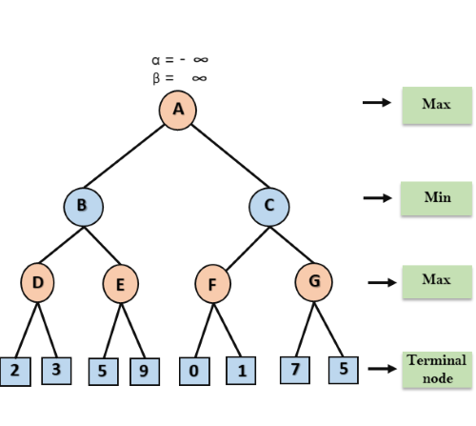
Continue…

Slide 36
Continue…
Step 2: At Node D, the value of α will be calculated as its turn for Max. The value of α is compared with firstly 2 and then 3, and the max (2, 3) = 3 will be the value of α at node D and node value will also 3.
Step 3: Now algorithm backtrack to node B, where the value of β will change as this is a turn of Min, Now β= +∞, will compare with the available subsequent nodes value, i.e. min (∞, 3) = 3, hence at node B now α= -∞, and β= 3.

Slide 37
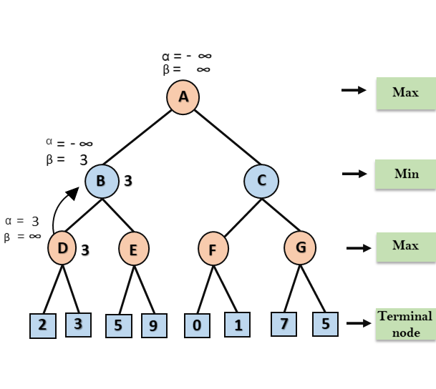
Continue…

Slide 38
Continue…
In the next step, algorithm traverse the next successor of Node B which is node E, and the values of α= -∞, and β= 3 will also be passed.

Slide 39
Continue…
Step 4: At node E, Max will take its turn, and the value of alpha will change. The current value of alpha will be compared with 5, so max (-∞, 5) = 5, hence at node E α= 5 and β= 3, where α>=β, so the right successor of E will be pruned, and algorithm will not traverse it, and the value at node E will be 5.

Slide 40
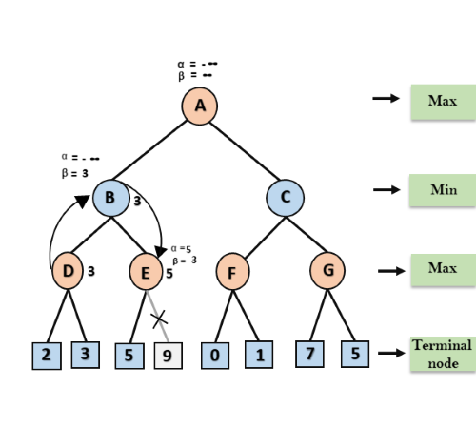
Continue…

Slide 41
Continue…
Step 5: At next step, algorithm again backtrack the tree, from node B to node A. At node A, the value of alpha will be changed the maximum available value is 3 as max (-∞, 3)= 3, and β= +∞, these two values now passes to right successor of A which is Node C.
At node C, α=3 and β= +∞, and the same values will be passed on to node F.
Step 6: At node F, again the value of α will be compared with left child which is 0, and max(3,0)= 3, and then compared with right child which is 1, and max(3,1)= 3 still α remains 3, but the node value of F will become 1.

Slide 42
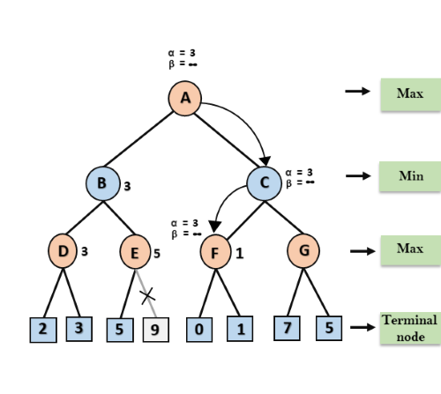
Continue…

Slide 43
Continue…
Step 7: Node F returns the node value 1 to node C, at C α= 3 and β= +∞, here the value of beta will be changed, it will compare with 1 so min (∞, 1) = 1. Now at C, α=3 and β= 1, and again it satisfies the condition α>=β, so the next child of C which is G will be pruned, and the algorithm will not compute the entire sub-tree G.

Slide 44
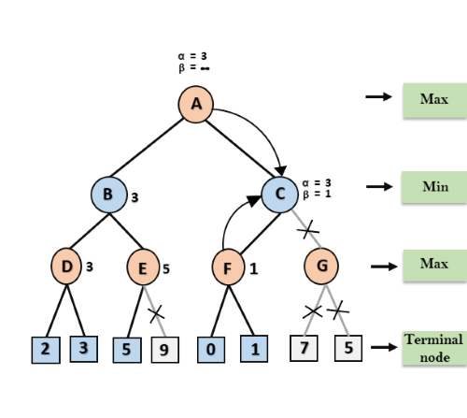
Continue…

Slide 45
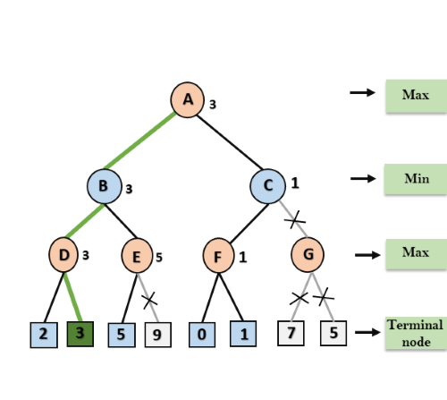
Continue…
Step 8: C now returns the value of 1 to A here the best value for A is max (3, 1) = 3. Following is the final game tree which is the showing the nodes which are computed and nodes which has never computed. Hence the optimal value for the maximizer is 3 for this example.

Slide 46
Continue…

Slide 47
Youtube & NPTEL Video Links and Online Courses Details
Youtube/other Video Links
https://www.youtube.com/watch?v=gZpUcsB9TFc
https://www.youtube.com/watch?v=G1Ilfpanz9A
https://www.youtube.com/watch?v=5LVR3mxEzmE
https://www.youtube.com/watch?v=_i-lZcbWkps
NPTEL Courses Link
https://nptel.ac.in/courses/106105077/

Slide 48
Daily Quiz
Which search is implemented with an empty first-in-first-out queue?
a) Depth-first search
b) Breadth-first search
c) Bidirectional search
d) None of the mentioned
Answer: b
Explanation: Because of FIFO queue, it will assure that the nodes that are visited first will be expanded first.

Slide 49
Daily Quiz
A* algorithm is based on ___________
a) Breadth-First-Search
b) Depth-First –Search
c) Best-First-Search
d) Hill climbing
Answer: c
Explanation: Best-first-search is giving the idea of optimization and quick choose of path, and all these characteristic lies in A* algorithm.

Slide 50
Daily Quiz
The search strategy the uses a problem specific knowledge is known as ___________
a) Informed Search
b) Best First Search
c) Heuristic Search
d) All of the mentioned
Answer: d
.

Slide 51
Daily Quiz
A complete, local search algorithm always finds goal if one exists, an optimal algorithm always finds a global minimum/maximum.
a) True
b) False
Answer: a
Explanation: An algorithm is complete if it finds a solution if exists and optimal if finds optimal goal (minimum or maximum).

Slide 52
Daily Quiz
When will Hill-Climbing algorithm terminate?
a) Stopping criterion met
b) Global Min/Max is achieved
c) No neighbor has higher value
d) All of the mentioned
Answer: c
Explanation: When no neighbor is having higher value, algorithm terminates fetching local min/max.

Slide 53
Daily Quiz
To which depth does the alpha-beta pruning can be applied?
a) 10 states
b) 8 States
c) 6 States
d) Any depth
Answer: d
Explanation: Alpha–beta pruning can be applied to trees of any depth and it is possible to prune entire subtree rather than leaves.

Slide 54
Weekly Assignment
Q1: Demonstrate shortcomings of Hill Climbing Search and it’s variations. CO2
Q2: Explore Heuristic functions and Effective Branching Factor. CO2
Q3: List out benefits of Recursive Breadth First Search. CO2
Q4: Inspect and find use of branching factor in Heuristic function. CO2
Q5: List out various searching methodologies. CO2
Q6: Inspect and find the complete and optimal algorithm among BFS, Greedy BFS and A*. CO2

Slide 55
MCQ s
Which search strategy is also called as blind search?
a) Uninformed search
b) Informed search
c) Simple reflex search
d) All of the mentioned
Answer: a
Explanation: In blind search, We can search the states without having any additional information. So uninformed search method is blind search.

Slide 56
MCQ s
How many types are available in uninformed search method?
a) 3
b) 4
c) 5
d) 6
Answer: c
Explanation: The five types of uninformed search method are Breadth-first, Uniform-cost, Depth-first, Depth-limited and Bidirectional search.

Slide 57
MCQ s
A heuristic is a way of trying ___________
a) To discover something or an idea embedded in a program
b) To search and measure how far a node in a search tree seems to be from a goal
c) To compare two nodes in a search tree to see if one is better than another
d) All of the mentioned
Answer: d
Explanation: In a heuristic approach, we discover certain idea and use heuristic functions to search for a goal and predicates to compare nodes.

Slide 58
MCQ s
In many problems the path to goal is irrelevant, this class of problems can be solved using ____________
a) Informed Search Techniques
b) Uninformed Search Techniques
c) Local Search Techniques
d) Informed & Uninformed Search Techniques
Answer: c

Slide 59
MCQ s
Explanation: If the path to the goal does not matter, we might consider a different class of algorithms, ones that do not worry about paths at all. Local search algorithms operate using a single current state (rather than multiple paths) and generally move only to neighbors of that state.

Slide 60
MCQ s
Uninformed search strategies are better than informed search strategies.
a) True
b) False
Answer: a
Explanation: Informed search strategies uses some problem specific knowledge, hence more efficient to finding goals.

Slide 61
MCQ s
Though local search algorithms are not systematic, key advantages would include __________
a) Less memory
b) More time
c) Finds a solution in large infinite space
d) Less memory & Finds a solution in large infinite space
Answer: d

Slide 62
MCQ s
Explanation: Two advantages:
(1) they use very little memory-usually a constant amount; and
(2) they can often find reasonable solutions in large or infinite (continuous) state spaces for which systematic algorithms are unsuitable.

Slide 63
MCQ s
Which search is similar to minimax search?
a) Hill-climbing search
b) Depth-first search
c) Breadth-first search
d) All of the mentioned
Answer: b
Explanation: The minimax search is depth-first search, So at one time we just have to consider the nodes along a single path in the tree.

Slide 64
Expected Questions for University Exam
List out various searching methodologies.
Inspect and find the complete and optimal algorithm among BFS, Greedy BFS and A*.
Explain Alpha - Beta Pruning with example.

Slide 65
Summary
After successfully completed this course student will be able to:
Understand about assess the applicability, strengths, and weaknesses of the basic knowledge representation, problem solving, and learning methods in solving particular engineering problems.

Slide 66
References
American Association for Artificial Intelligence (AAAI), Welcome to AI Topics, 2003, http://www.aaai.org/AITopics/ -- a Web-based library.
George Luger, Artificial Intelligence: Structures and Strategies for Complex Problem Solving, Fourth Edition Addison-Wesley, 2002 -- a well-respected introduction to artificial intelligence, as witnessed by its being in its fourth edition.
Peter Norvig, AI on the Web, http://aima.cs.berkeley.edu/ai.html -- a list of over 800 links on various aspects of artificial intelligence.

Slide 67


